Slide 1
AsyncIO - Zero to Hero
Eyal Balla
January 5th 2022

Slide 2

About me
Leading development teams for the last 15 years
I’ve been working in python for the last 5 years
Currently a Team Leader in Cynerio
You can find me at:
www.linkedin.com/in/eyal-balla
Email: eyal@cynerio.co

Slide 3
Agenda for today
What is AsyncIO
Real world example from our day to day
Advanced
Exceptions
Testing
Debugging

Slide 4
What is AsyncIO
A style of concurrent programming in python

Slide 5
Multi Process
OS handles concurrency
Only option for multi-core processing
Duplicated memory usage
Need OS level communication channels

Slide 6
Multi Threading
OS level concurrency
GIL locks

Slide 7
Async IO
IO events management
Multiple states managed in the same thread
Application-level context switching

Slide 8
Proccess – Threads - Async
 | Process | Threads | Async
Concurrency | Yes (OS level) | Yes (OS level) | Yes (application level)
Use all CPU cores | Yes | No | No
Scalability | 1-10 | 100s | 1000s
Use blocking components (std lib, requests etc) | Yes | Yes | No

Slide 9
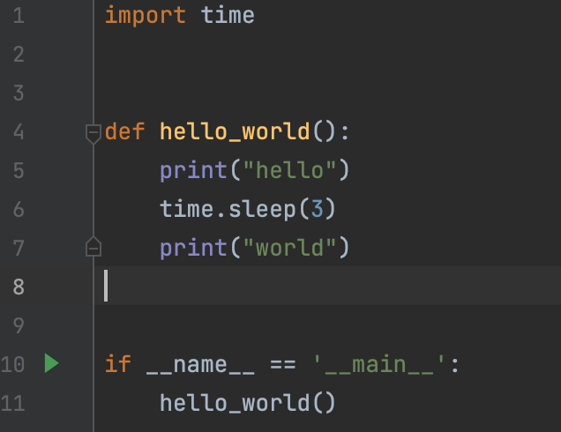
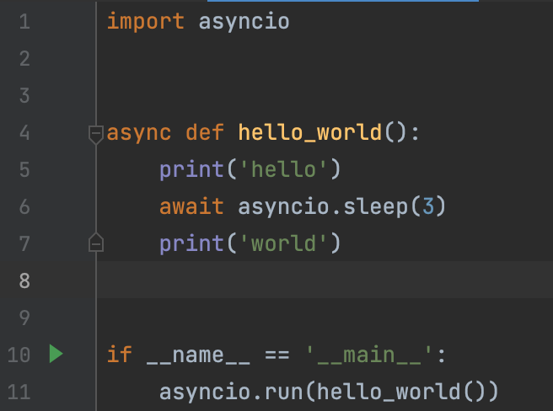
Most used asyncio sample ever
Not really relevant to any of us

Slide 10
Async IO in the Real world - When?
IO heavy processes
Database access
Web requests
File sharing services (S3)
Use together with multi-process (multi node in cloud environments)

Slide 11
Almost a different language
Do not use long computations - blocks event queue
Do not use OS blocking:
socket.create_connection
select
Waitpid
time.sleep

Slide 12
Almost a different language
Different libraries:
 | Regular | AsyncIO
HTTP requests | Requests | Httpx
Web server | flask, django | Fastapi, aiohttp, sanic, django (limited)
Postgres | Psycopg2 | Asyncpg
Kafka | Kafka-python | Aiokafka
AWS | boto3 | aioboto

Slide 13
AsyncIO – Main building blocks
asyncio.run(coroutine) – creates an event loop and runs the coroutine in it. Main entry point to asyn functionality
async def function()
asyncio.create_task(coroutine) – creates a task and schedules it for running on current loop
await coroutine – releases the control to the next event in the loop until coroutine is completed

Slide 14
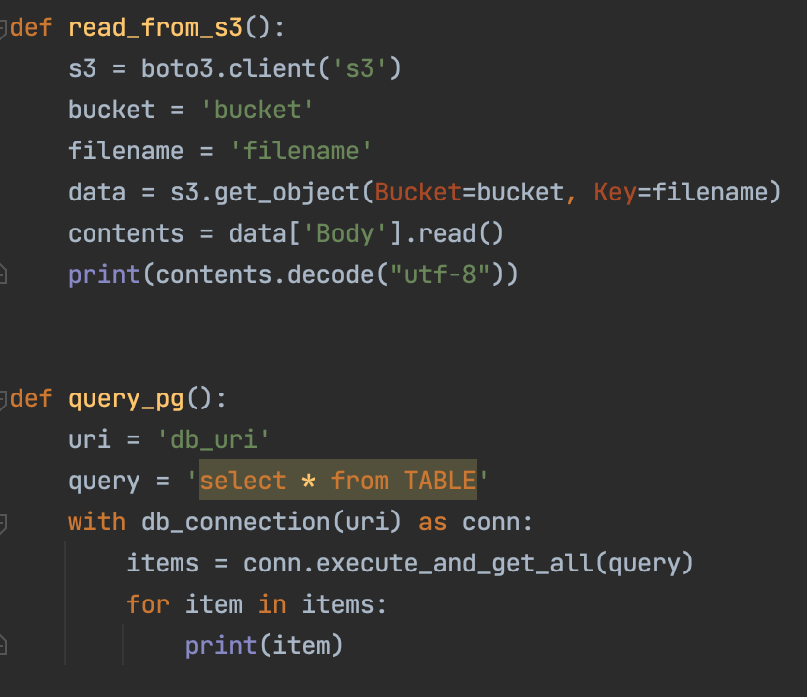
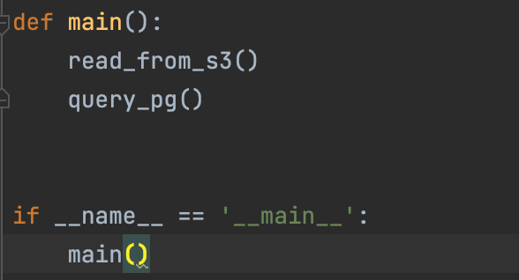
AsyncIO – Using Main building blocks – sync version

Slide 15
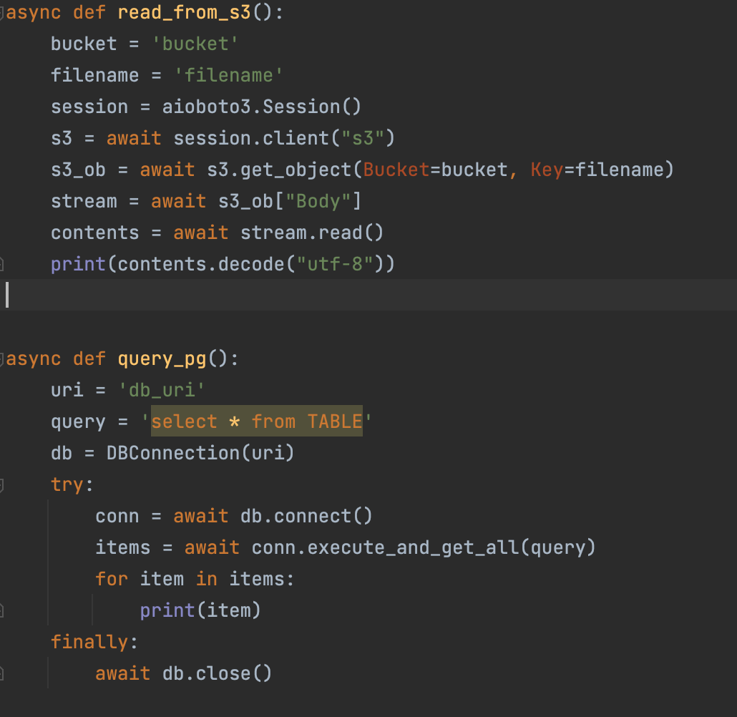
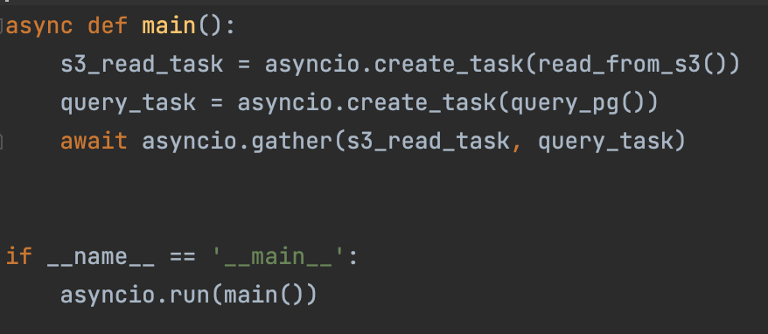
AsyncIO – Using Main building blocks – async version

Slide 16
AsyncIO – Some more concepts
async with asynccontextmanager() as context:
async for item in async_iterable

Slide 17
Example A problem from our day-to-day work

Slide 18
A problem from our day-to-day work Data enrichment
For each customer:
For each entity read data from external source
Aggregate information into some new properties for our entities
Write into our db the updated state per entity
Scale - per customer – 10000s of entities

Slide 19
Naïve Implementation
Cron job once a while:
Go over customers
Get data per customer and update database

Slide 20
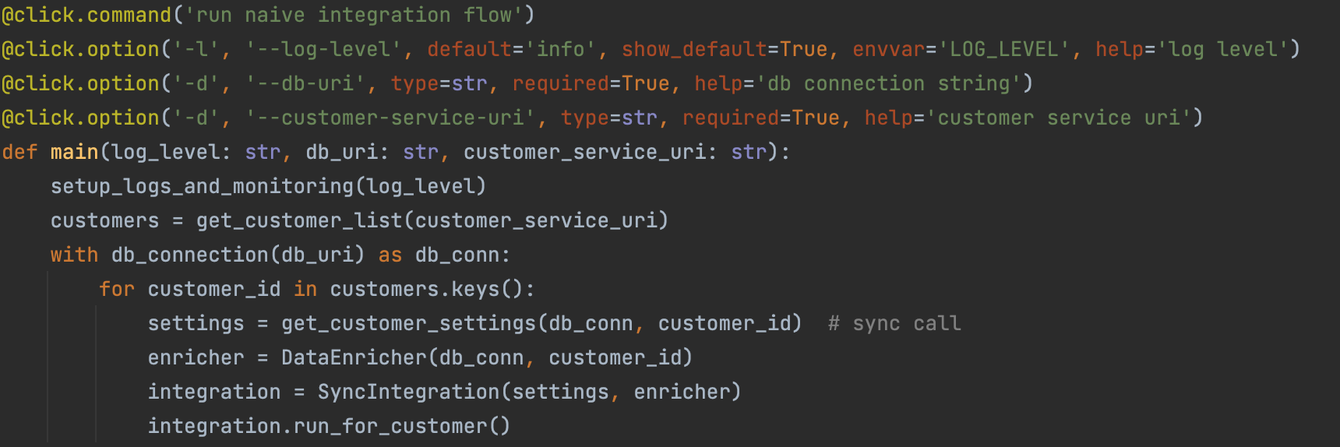
Naïve Implementation – Service Main

Slide 21
Naïve Implementation – Service Main

Slide 22
Naïve Implementation – Service Main

Slide 23
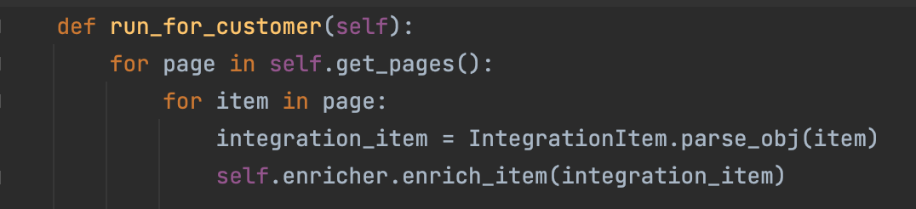
Naïve implemention – run_for_customer

Slide 24
Naïve implemention – run_for_customer

Slide 25
Naïve implementation - issues
Most of the time spent on waiting for IO:
Network requests
Database request
Customers with large datasets impact small customer SLA
Once total time of handling is larger than cron time, system does not function as planned

Slide 26
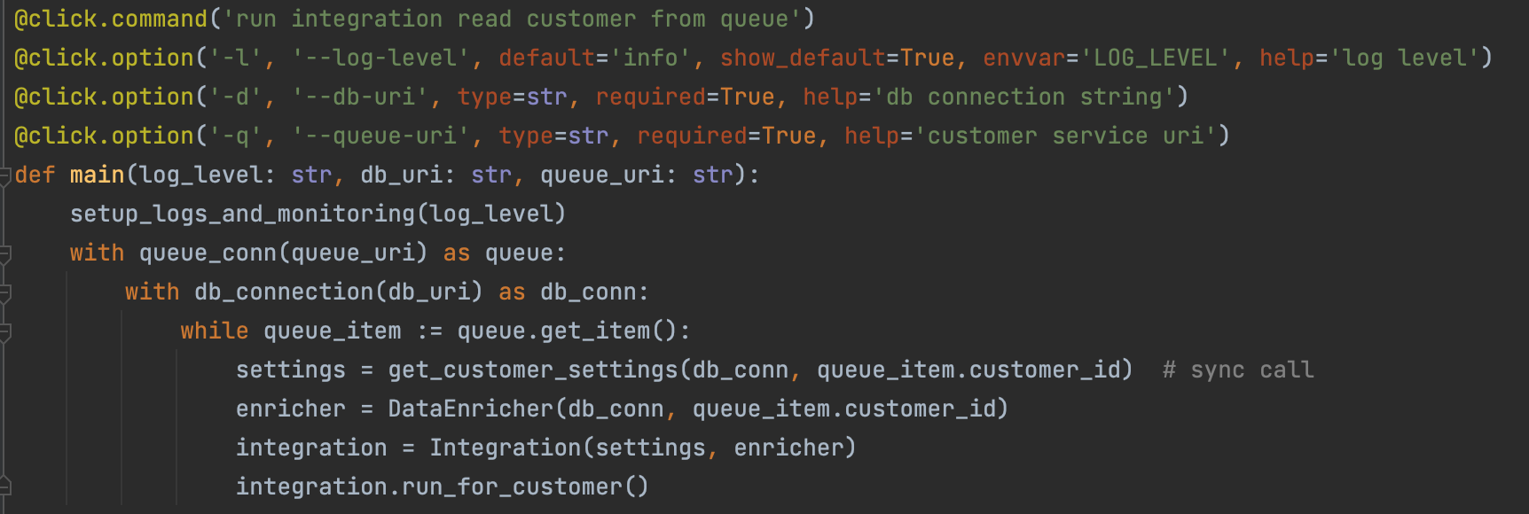
Phase I: schedule customers separatly using a queue

Slide 27
Phase I: schedule customers separatly using a queue

Slide 28
Phase I: Analysis
Still waiting on IO most of the time
Can scale out to have multiple instances of the service serve different customers
Total performance is not blocked
Small customers are not impacted by large customers

Slide 29
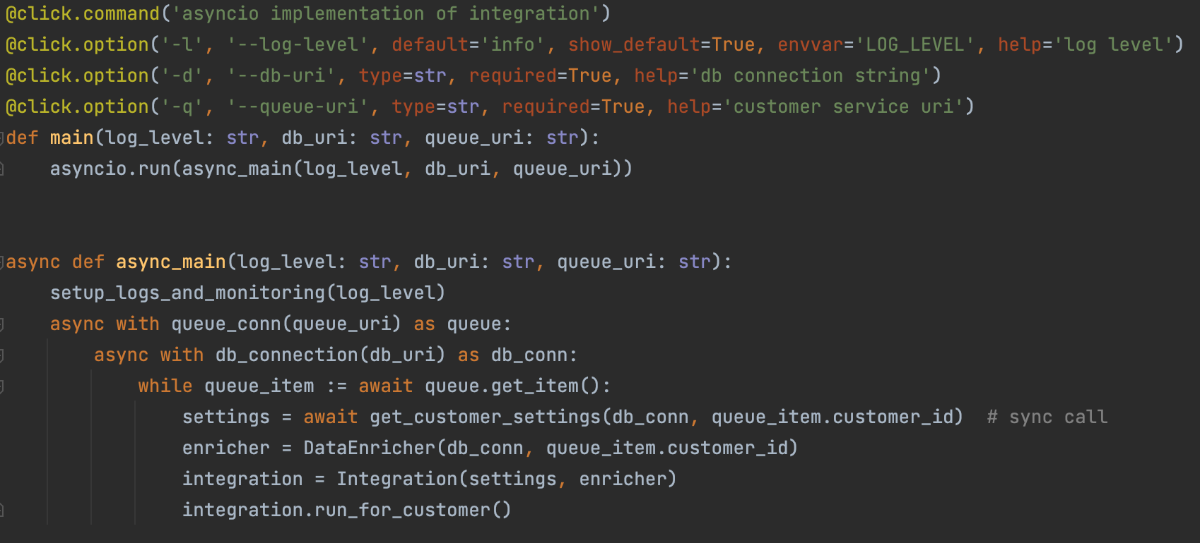
Phase II: Move to asyncio – main flow

Slide 30
Phase II: Move to asyncio – main flow

Slide 31
Phase II: Move to asyncio – main flow

Slide 32
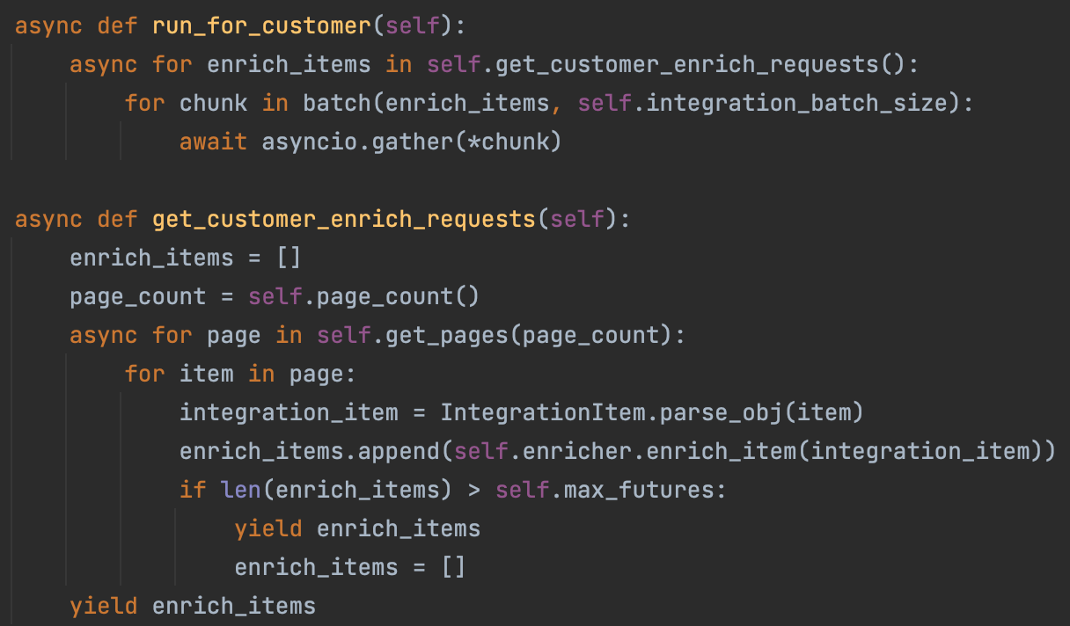
Phase II: Move to asyncio – run_for_customer

Slide 33
Phase II: Move to asyncio – run_for_customer

Slide 34
Phase II: Move to asyncio – run_for_customer

Slide 35
Phase II: Analysis
IO is no longer waited on and process of data enrichment happens in parallel to requests to database and network
Can scale out to have multiple instances of the service serve different customers
Total performance is not blocked
Small customers are not impacted by large customers

Slide 36
Advanced Some other items to keep in mind

Slide 37
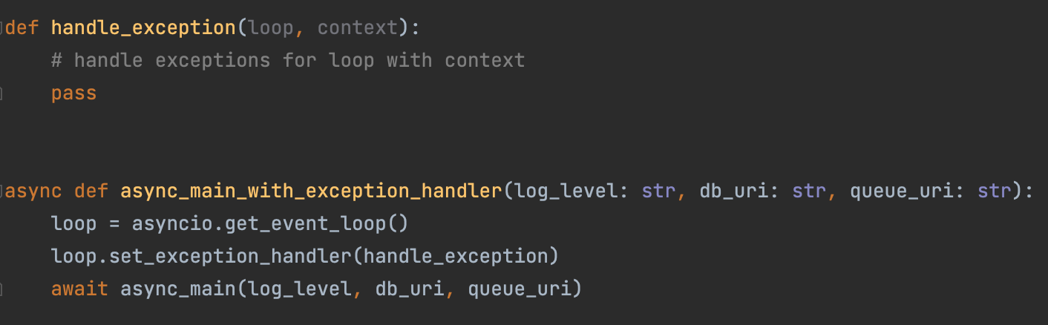
Exception handling
Default exception handler is to dump trace of coroutine with exception and continue consuming tasks
This can be changed by adding an exception handler

Slide 38
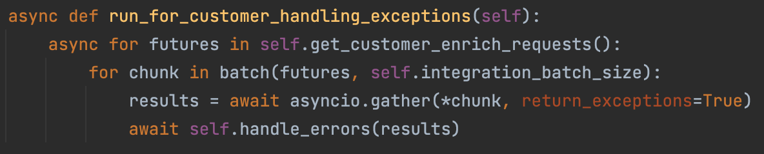
Specific exception handling
Exception handling can be done in specific context for invoking retry mechanisms

Slide 39
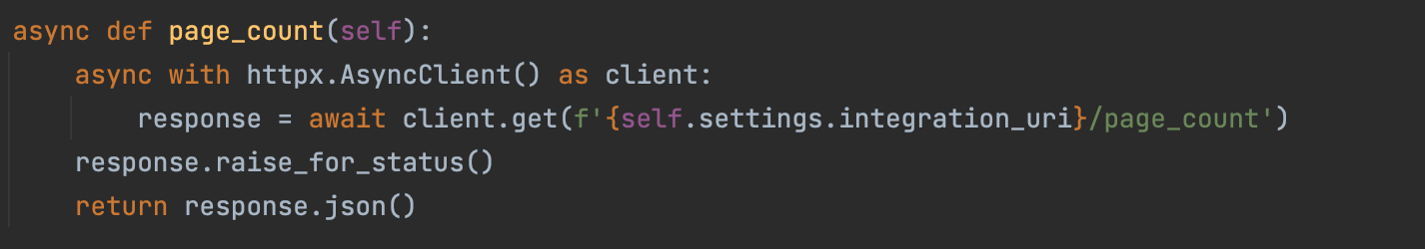
Testing using pytest
Test the following function of the async integration:
Relevant test cases are:
Response is ok – json is returned
Response not ok – exception is generated

Slide 40
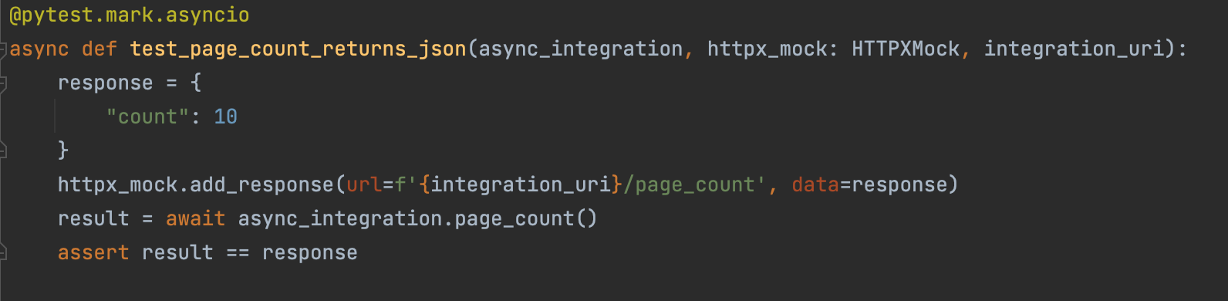
Testing using pytest
Using @pytest.mark.asyncio enables running tests in eventloop:
Network responses are mocked using pytest_httpx

Slide 41
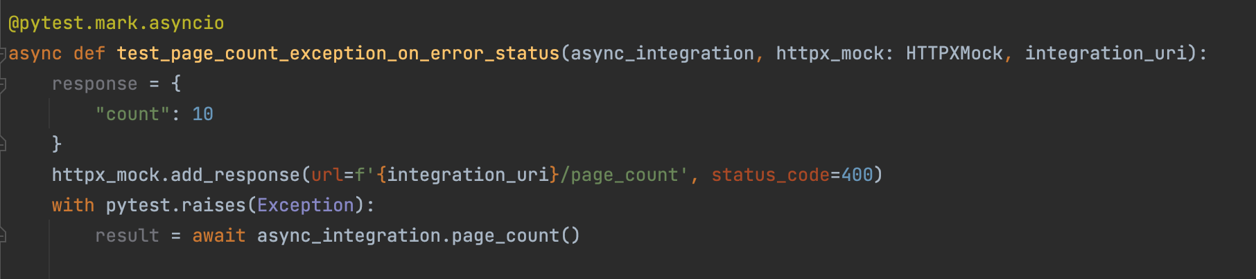
Testing using pytest
Same can be done for the exception case

Slide 42
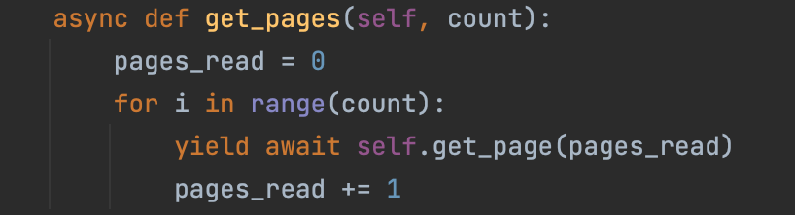
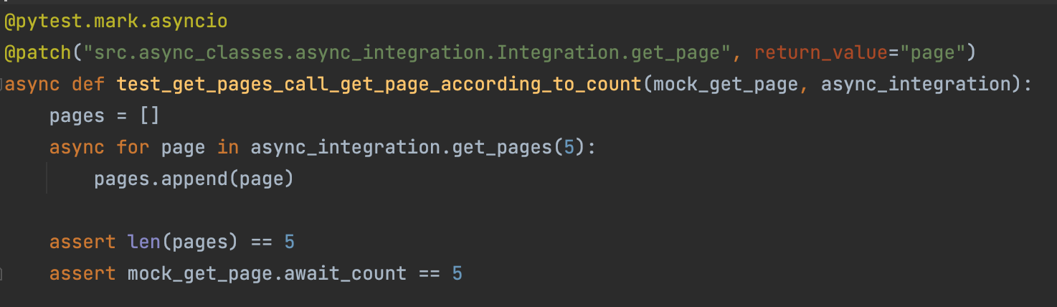
Testing using pytest – mocking coroutines
Unittest.mock added AsyncMock

Slide 43
Debugging – Debug mode
Run with: PYTHONASYNCIODEBUG=1
Gives traceback on when async function are not awaited
Monitors thread safety
Logs slow coroutines

Slide 44
Debugging – Debug mode
Run with: PYTHONASYNCIODEBUG=1
Gives traceback on when async function are not awaited
Monitors thread safety
Logs slow coroutines
async def very_slow():
time.sleep(4)
await very_slow()
Executing <Task finished name='Task-1' coro=<<module>() done, defined at <console>:1> result=None created at usr/local/Cellar/python@3.9/3.9.8/Frameworks/Python.framework/Versions/3.9/lib/python3.9/asyncio/__main__.py:50> took 4.006 seconds

Slide 45
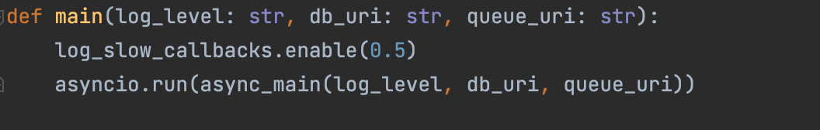
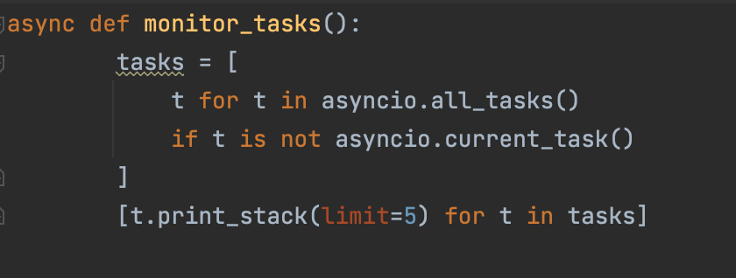
Debugging – in production
Use aiodebug:
Print trace during run using task.print_stack

Slide 46

What did we learn today ?
AsyncIO is a concurrent programming framework that works best in intensive IO environments
Visited a real world example
Howto Debug, Test and handle exceptions

Slide 47

Questions
You can find me at:
www.linkedin.com/in/eyal-balla
Email: eyal@cynerio.co

